Slide 1
CSE 5311: Design and Analysis of Algorithms
Instructor: Dr. Gautam Das TA: Shohedul Hasan Spring 2018
Project: Task Scheduler using Red-Black Trees
Group No.: 8
Kaustubh Agnihotri (1001554290)
Karthik Venkatasivareddy (1001518082)
Supreeth Javalli (1001518038)

Slide 2
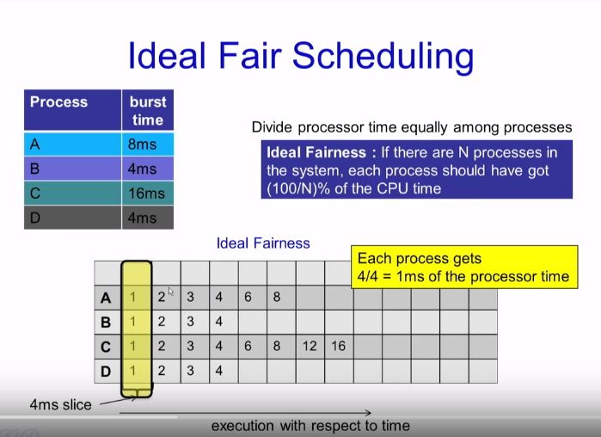
Completely Fair Scheduling Algorithm:

Slide 3
Completely Fair Scheduling Algorithm:
A "maximum execution time" is calculated for each process. This time is based upon the idea that an "ideal processor" would equally share processing power amongst all processes. Thus, the maximum execution time is the time the process has been waiting to run, divided by the total number of processes, or in other words, the maximum execution time is the time the process would have expected to run on an "ideal processor".

Slide 4
Completely Fair Scheduling Algorithm:
When the scheduler is invoked to run a new process, the operation of the scheduler is as follows:
The left most node of the scheduling tree is chosen (as it will have the lowest spent execution time), and sent for execution.
If the process simply completes execution, it is removed from the system and scheduling tree.
If the process reaches its maximum execution time or is otherwise stopped it is reinserted into the scheduling tree based on its new spent execution time.

Slide 5
Completely Fair Scheduling Algorithm:
The new left-most node will then be selected from the tree, repeating the iteration. If the process spends a lot of its time sleeping, then its spent time value is low and it automatically gets the priority boost when it finally needs it. Hence such tasks do not get less processor time than the tasks that are constantly running.
Refer here

Slide 6
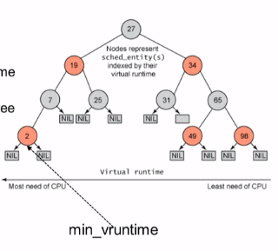
Picking next task to Run:
CFS uses a red-black tree.
Each node in the tree represents a runnable task.
Nodes ordered according to their vruntime.
Nodes on the left have lower vruntime compared to nodes on the right of the tree.
The left most node is the task with the least vruntime.

Slide 7
Why Red Black Tree?
No path in the tree will be twice as long as other path.
All operations are O(log n)
Thus inserting / deleting task from the tree is quick and efficient.
Creates a balanced structure.

Slide 8
How we implemented the algorithm?
Read the input file and sort it according to arrival time into an array
The first process (whenever tree is empty) is executed for quantum slice. While this process executes, other processes might arrive and wait
After execution is completed, if the process still has time left, it is inserted into the tree
Now all the processes which have arrived while 1st process was executing are also inserted into the tree

Slide 9
How we implemented the algorithm?
The unfairness score is calculated for each process based upon the arrival time and spent time as unfairnessScore = arrivalTime + spentTime
This ensures that the process with the least spent time goes to the left most leaf
Now we extract the left most process and execute it by calculating the maximum_execution time as stated above
Thus every time the process which has waited the most (or spent least time using the CPU) is selected

Slide 10
What we found out using RB Tree and Heap (Priority queue)?
We performed many tests on the developed code and found out some unexpected results.
Heap performed better than red black tree data structure for most of the times.
The main reason behind this was that retrieving the minimum element from the heap is possible in O(1) time, whereas for the red black tree it took O(log n) time.
Let us go through some analysis using graphs that we generated from the test results.

Slide 11
Comparing RBT and Heap for following input:
Quantum Slice | No. of processes | RBT Execution time (ms) | Heap Execution time (ms)
4 | 5 | 1.245865 | 1.203199
8 | 10 | 1.383536 | 1.187839
12 | 50 | 4.044228 | 2.319358
16 | 100 | 5.058556 | 3.067446
20 | 500 | 13.829108 | 10.187654
40 | 1000 | 17.836927 | 13.820575
60 | 5000 | 88.697666 | 68.661985
80 | 10000 | 161.868662 | 135.595119
100 | 50000 | 1528.531461 | 640.667329
120 | 100000 | 2721.570655 | 2132.328562
200 | 500000 | 24880.85144 | 22870.75936
320 | 1000000 | 87586.74979 | 74442.86256

Slide 13
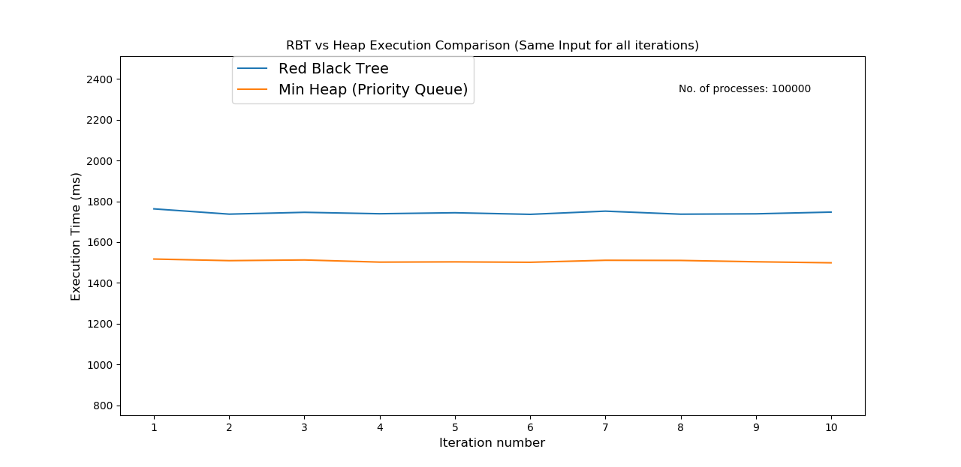

Slide 14
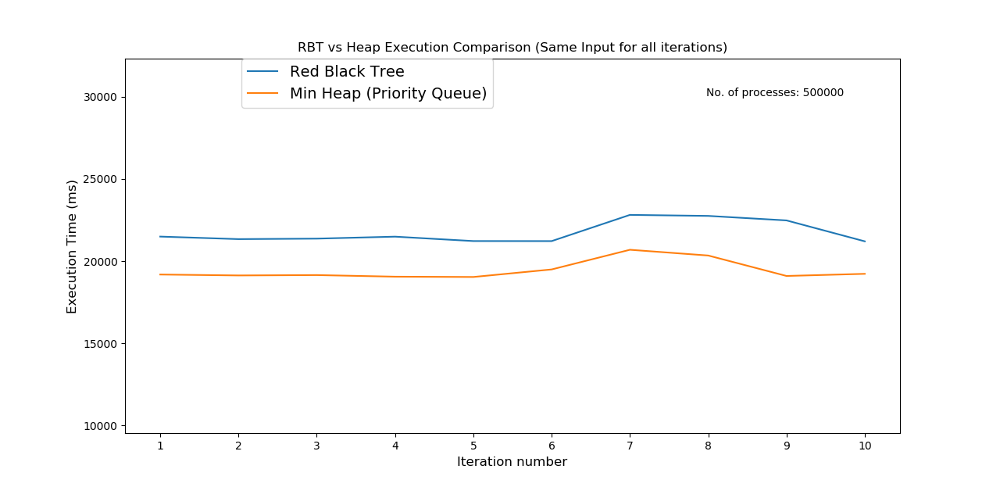

Slide 15
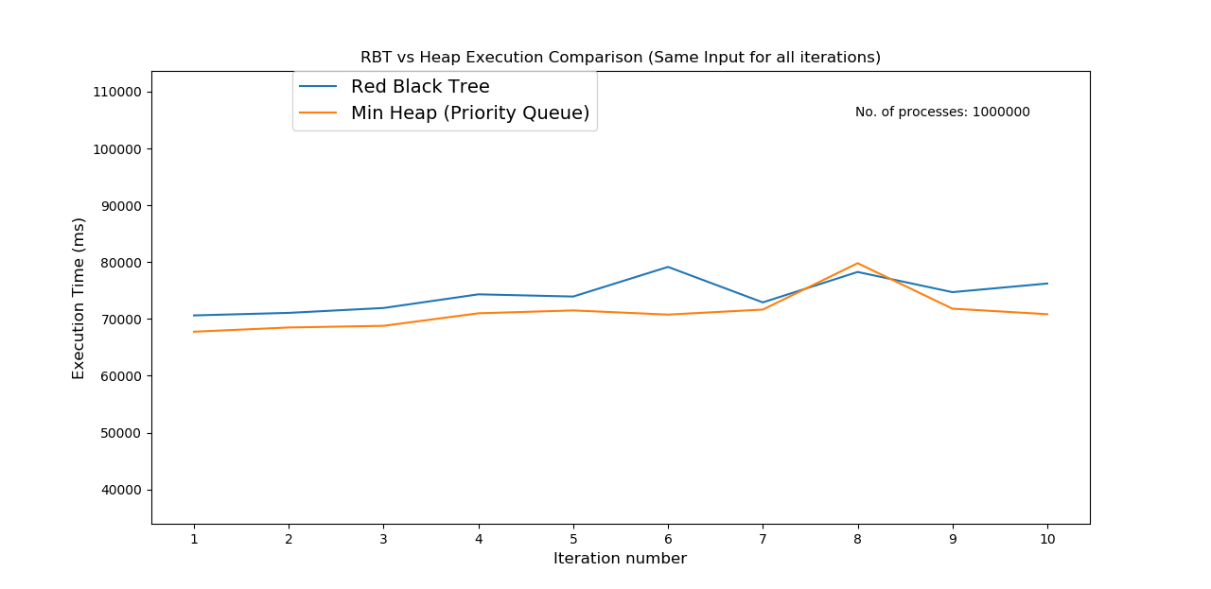

Slide 16
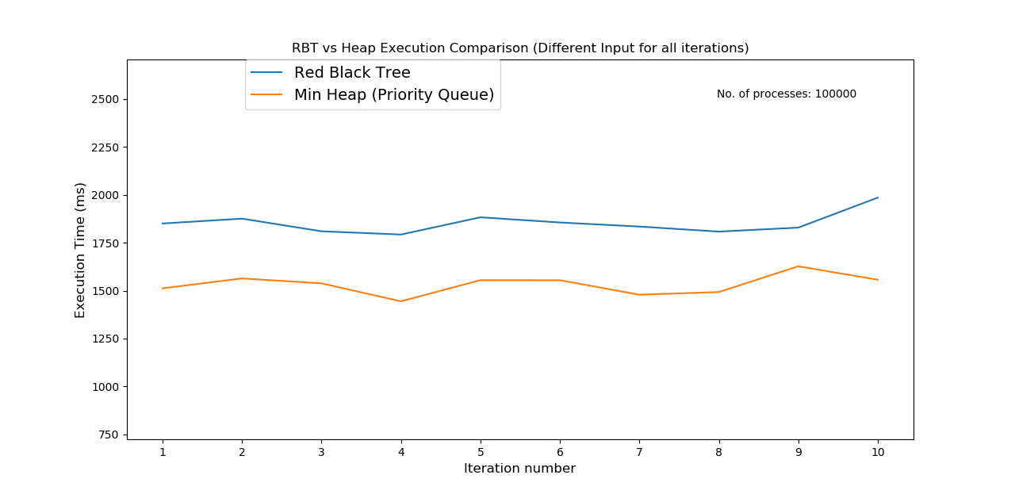

Slide 17
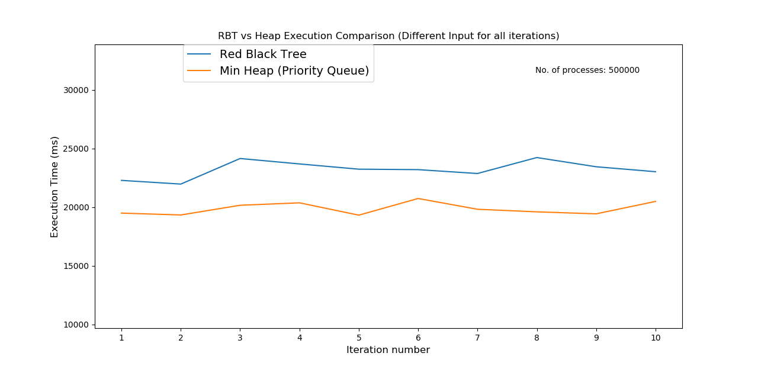

Slide 18
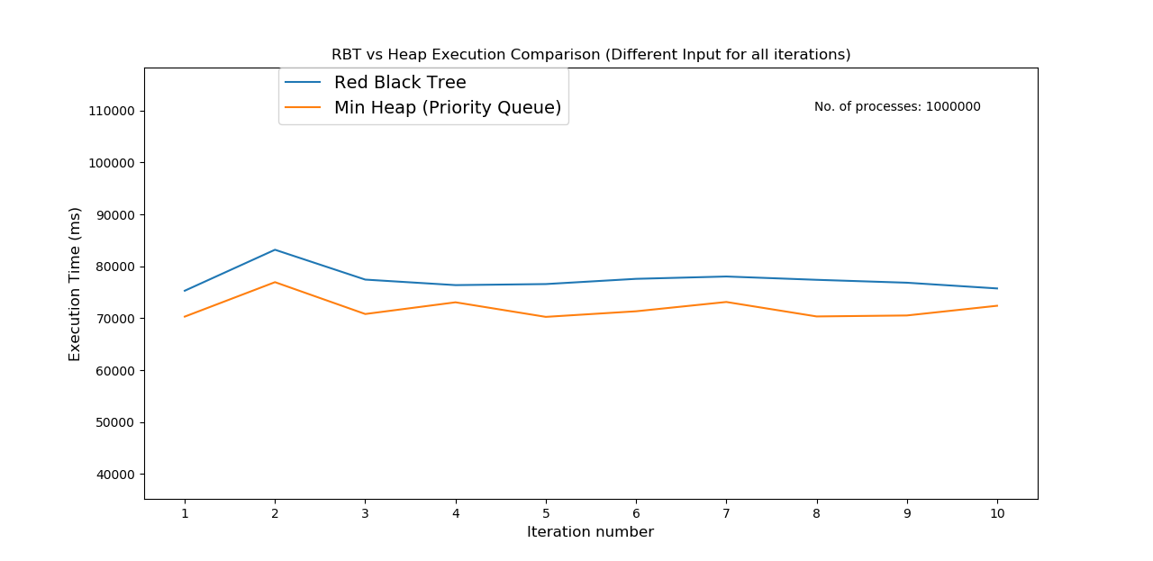

Slide 19
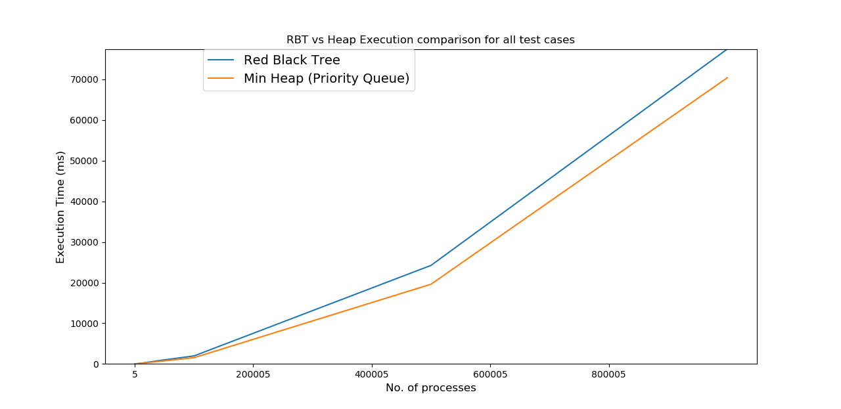

Slide 20
Why CFS uses RB Tree if Heap performed better?
Implementing heap in Linux requires contiguous memory allocation which becomes tough ask as the multi-programming grows. Thus space requirement is a hurdle in implementing heap. (Refer this)

Slide 21
References
https://en.wikipedia.org/wiki/Completely_Fair_Scheduler
https://www.alouche.net/2012/02/04/linux-cfs-algorithm-and-virtual-runtime/
https://www.linuxjournal.com/node/10267
https://stackoverflow.com/questions/33191110/reason-why-cfs-scheduler-using-red-black-tree?utm_medium=organic&utm_source=google_rich_qa&utm_campaign=google_rich_qa

Slide 22
Thank You

